Slide 1
QR Code Generator
Create and share your message in seconds

Slide 2
Team Members
Name | Roll No
AUTI AKSHADA VILAS | 41622
GHUGE RUSHIKESH MURLIDHAR | 41631
WAGH VAIBHAV DATTA | 41636

Slide 3
Problem Statement
To create a user-friendly and efficient QR code generator website that can help users create custom QR codes for various purposes, such as sharing links, contact information, product details, and more, without any technical knowledge.

Slide 4
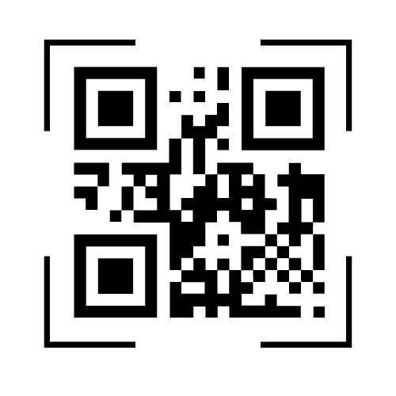
Objective
To provide a simple and efficient way for users to create custom QR codes for their various needs, such as sharing links, contact information, product details, and more.
To create a user-friendly interface that allows users to generate QR codes quickly and easily, without the need for any technical expertise.
To offer a free and accessible platform for anyone to create QR codes for their personal or professional use.

Slide 5
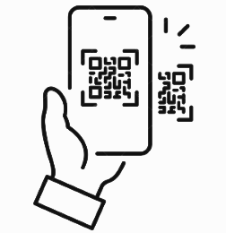
Objectives
To ensure the generated QR codes are scannable and compatible with various devices and applications.
To allow users to save and download the generated QR codes in various formats, such as PNG, SVG, and PDF, for easy integration into their marketing materials or websites.
To ensure the website is secure and reliable, protecting users' data and privacy.

Slide 6
Goal and Purpose
The goal of a QR code generator website is to provide a quick and easy way for users to create custom QR codes for their various needs, without any technical knowledge or expertise. The website should have a user-friendly interface and offer various customization options to cater to the diverse needs of users.
The purpose of a QR code generator website is to help businesses and individuals efficiently communicate with their target audience by providing a simple and effective way to share information. By creating custom QR codes, users can easily share links, contact information, product details, and more with their customers and peers. The website should also be free and accessible to all users, providing a platform that enables anyone to create QR codes for personal or professional use.

Slide 7
Scope
Creating QR codes for various types of information, including text, URL links, phone numbers, email addresses, and more.
Ensuring the generated QR codes are scannable and compatible with various devices and applications.
Allowing users to save and download the generated QR codes in various formats.
Providing a user-friendly interface that enables users to generate QR codes quickly and easily, without the need for any technical knowledge or expertise.
Ensuring the website is secure and reliable, protecting users' data and privacy.
Offering a free and accessible platform for anyone to create QR codes for personal or professional use, without any limitations or restrictions.

Slide 8

Existing and Proposed System
User Interface: The proposed system is designed to have a user-friendly interface that enables users to generate QR codes quickly and easily without any technical knowledge. This is in contrast to some of the existing systems, which may have a steeper learning curve and more complex interfaces.

Slide 9

Existing and Proposed System
Accessibility: The proposed system is designed to be accessible from any device with an internet connection, making it easy for users to generate QR codes on-the-go. This is in contrast to some of the existing systems that may require users to download and install software or plugins to generate QR codes.

Slide 10
Existing and Proposed System
Security: The proposed system ensures the website is secure and reliable, protecting users' data and privacy, which may not be the case for some of the existing systems

Slide 11
Thank You!!!

